Slide 1
Predicting tags/topics for interview questions datasets using NLP
presentated by sethu Ramanujam shashi

Slide 2
Problem definition
Using text classification methods to predict the tags for interview questions posted in Careercup, Github repositories using Natural Language Processing (NLP).
Forums rely on the tags of questions to match them to users who can provide answers. However, new users or novice developers may not tag their posts correctly.
This leads to posts being filtered and do not show up on the search result even though the question may be relevant and adds value to the community.

Slide 3
Exploratory Data Analysis (EDA)
Exploratory Data Analysis is one of the important steps in the data analysis process.
The main focus is on making sense of the data in hand .
Like formulating the correct questions to ask to your dataset, how to manipulate the data sources to get the required answers etc.

Slide 4

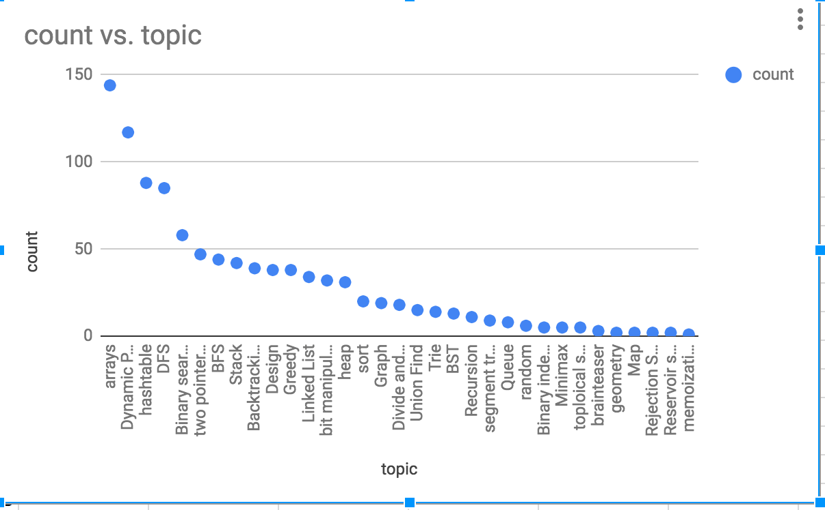
Datasets
Training data: Sources : LeetCode, Github (2k)
Test Data: Sources : Careercup (15k)

Slide 5

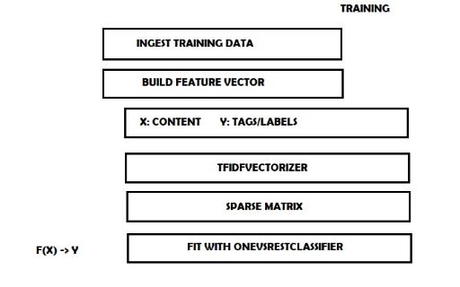
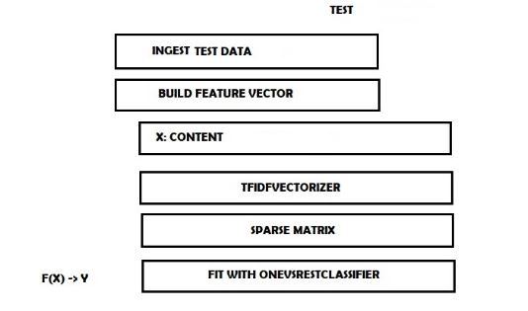
Approach used

Slide 6
classifiers
Multi-label classification techniques
OnevsRest : Also known as one-vs-all, this strategy consists in fitting one classifier per class. For each classifier, the class is fitted against all the other classes.

Slide 7
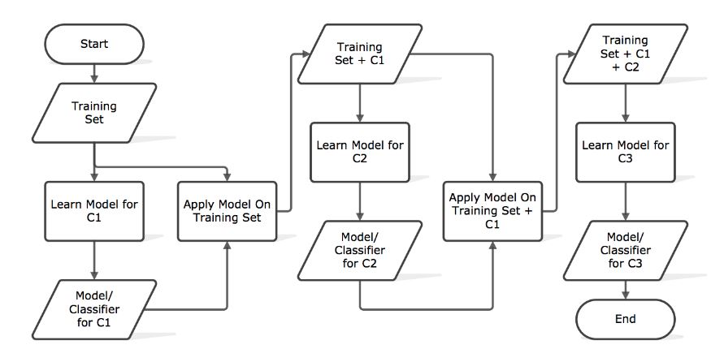
classsifiers
Classifier Chain : A chain of binary classifiers C0, C1, . . . , Cn is constructed, where a classifier Ci uses the predictions of all the classifier Cj , where j < i. This way the method, also called classifier chains (CC), can take into account label correlations.
The total number of classifiers needed for this approach is equal to the number of classes, but the training of the classifiers is more involved.

Slide 8
Tools used
BEAUTIFULSOUP LIBRARY FOR PARSING
PYTHON REQUESTS
CSV
PANDAS
SCIKIT LEARN

Slide 9
High level summary of the project process
Data preprocessing and Data wrangling: -Removed null tags. -Removed stop words by using NLTK corpus. -Used NLTK Snowball Stemmer for Stemming. -Excluded all the punctuations, exclamations and general keywords in the sentences using regular expression. -Stripped all the spaces and converted to all lower case. -English stop_words from english Corpus.

Slide 10
High level summary of the project process
Data split - Used train_test_split with ratio 90:10
Used Tf-Idf vectorizer to convert the string in to numeric value - Have appropriate parameters set.
Have single training/testing dataset.
Use OneVsRestClassifier to solve multi-label.
Model Evaluation using accuracy score

